Slide 1
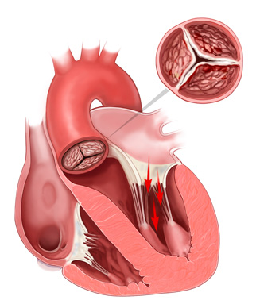
Aortic Valve Stenosis High Gradient Vs. Low Gradient
Hetal Gandhi MD FACC
Advocate Heart Institute

Slide 2
Introduction
Natural History
Pathophysiology and symptoms
Echocardiographic measurement
Low flow low gradient AS
Asymptomatic Severe AS
Management

Slide 3
Natural History of Aortic Stenosis
Most common valvular heart disease and third most prevalent form of cardiovascular disease in western world
Average rate of increase in mean pressure gradient is 4 to 7 mmhg per year
Valve area decline at average rate of 0.1 cm2/year, but some patients have little or no progression and other progress more rapidly
Aortic jet velocity is increase by an average of 0.3 m/s per year
Patients with mild disease (< 3.0 m/s jet velocity) less likely to develop symptoms over 5 years

Slide 4
A substantial number of patients with severe aortic stenosis are not yet symptomatic and risk of sudden cardiac death is low <1%/year but once symptomatic increase mortality 50% at 2 year
AHA/ACC 2014 guideline

Slide 5
Natural History of AS without treatment
Brawanwald E.aortic stenosis 1968 circulation

Slide 6
Aortic valve stenosis and low LVEF

Slide 8
Heart Failure reduces the life expectancy <2 years
Angina and Syncope reduces life expectancy between 2-5 years

Slide 9
Causes of Aortic stenosis
Supravalvular
Subvalular: Tunnel, Discrete
Valvular :
Congenital (1-30 years old)
Bicuspid (40-60 years old)
Rheumatic (40-60 years old)
Senile degenerative ( >65 years old)

Slide 10
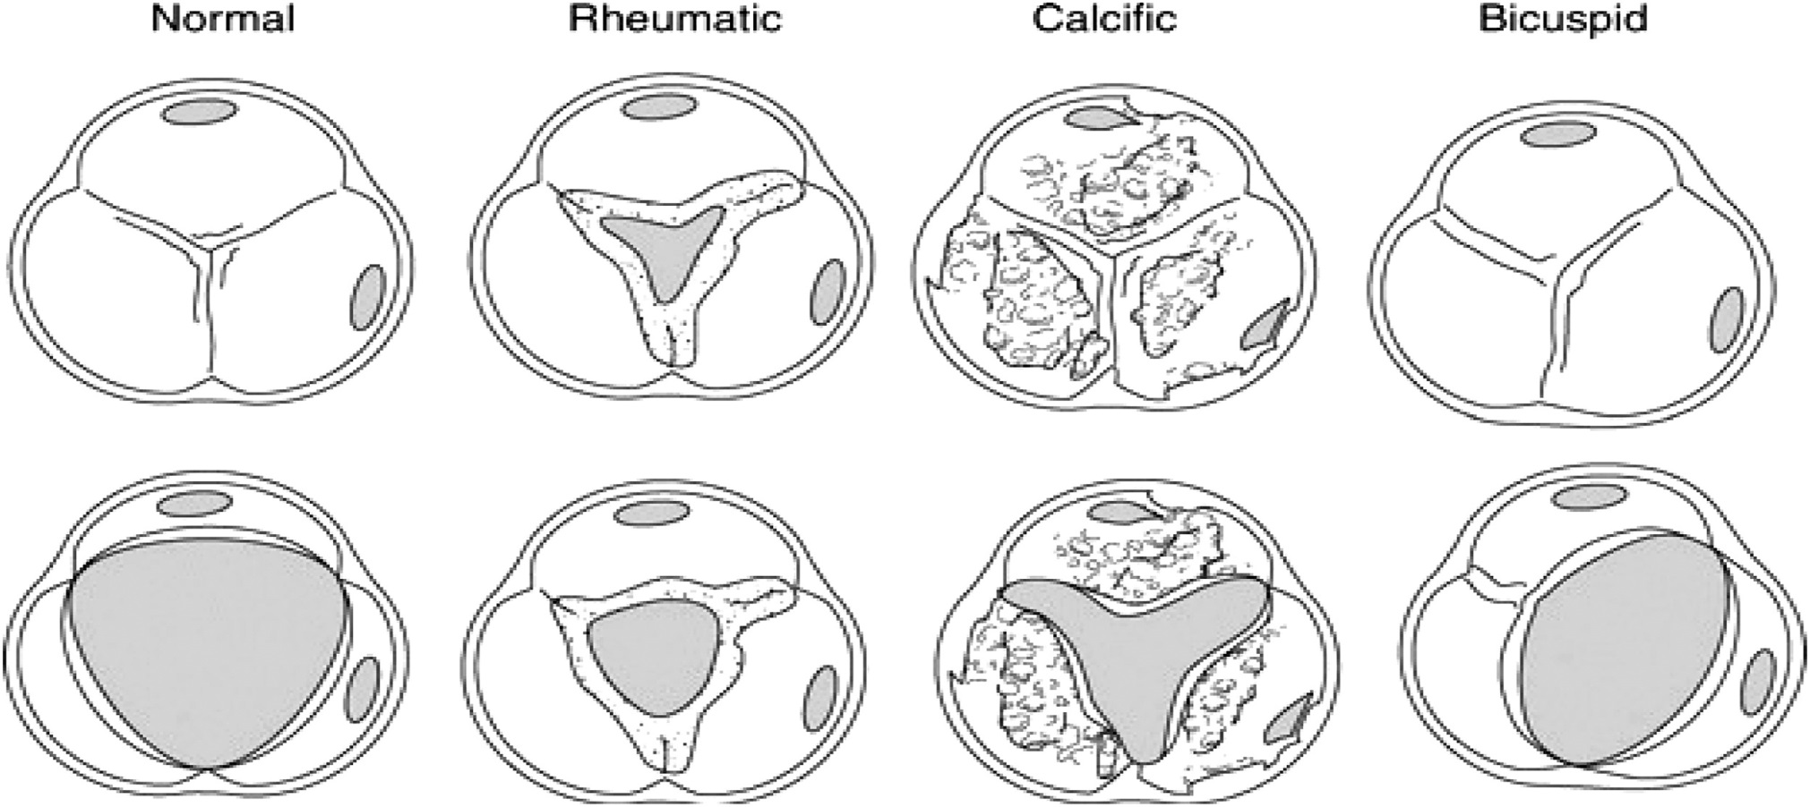
Aortic Valvular Morphology

Slide 11
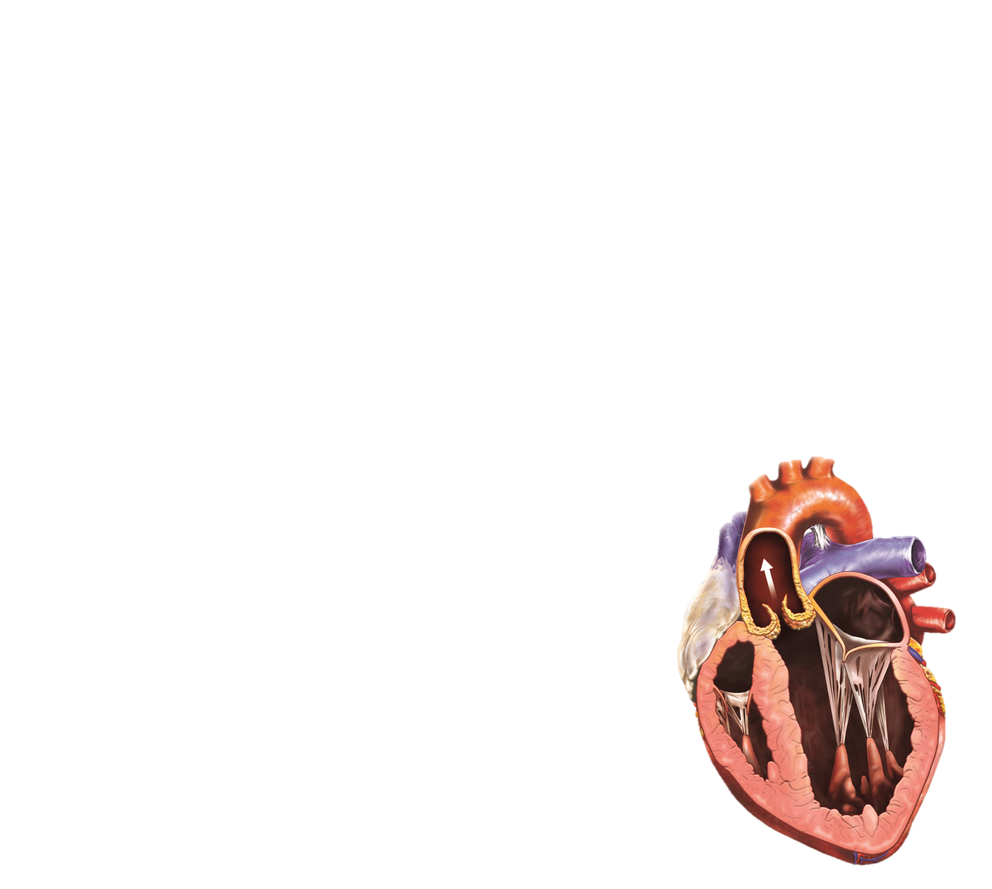
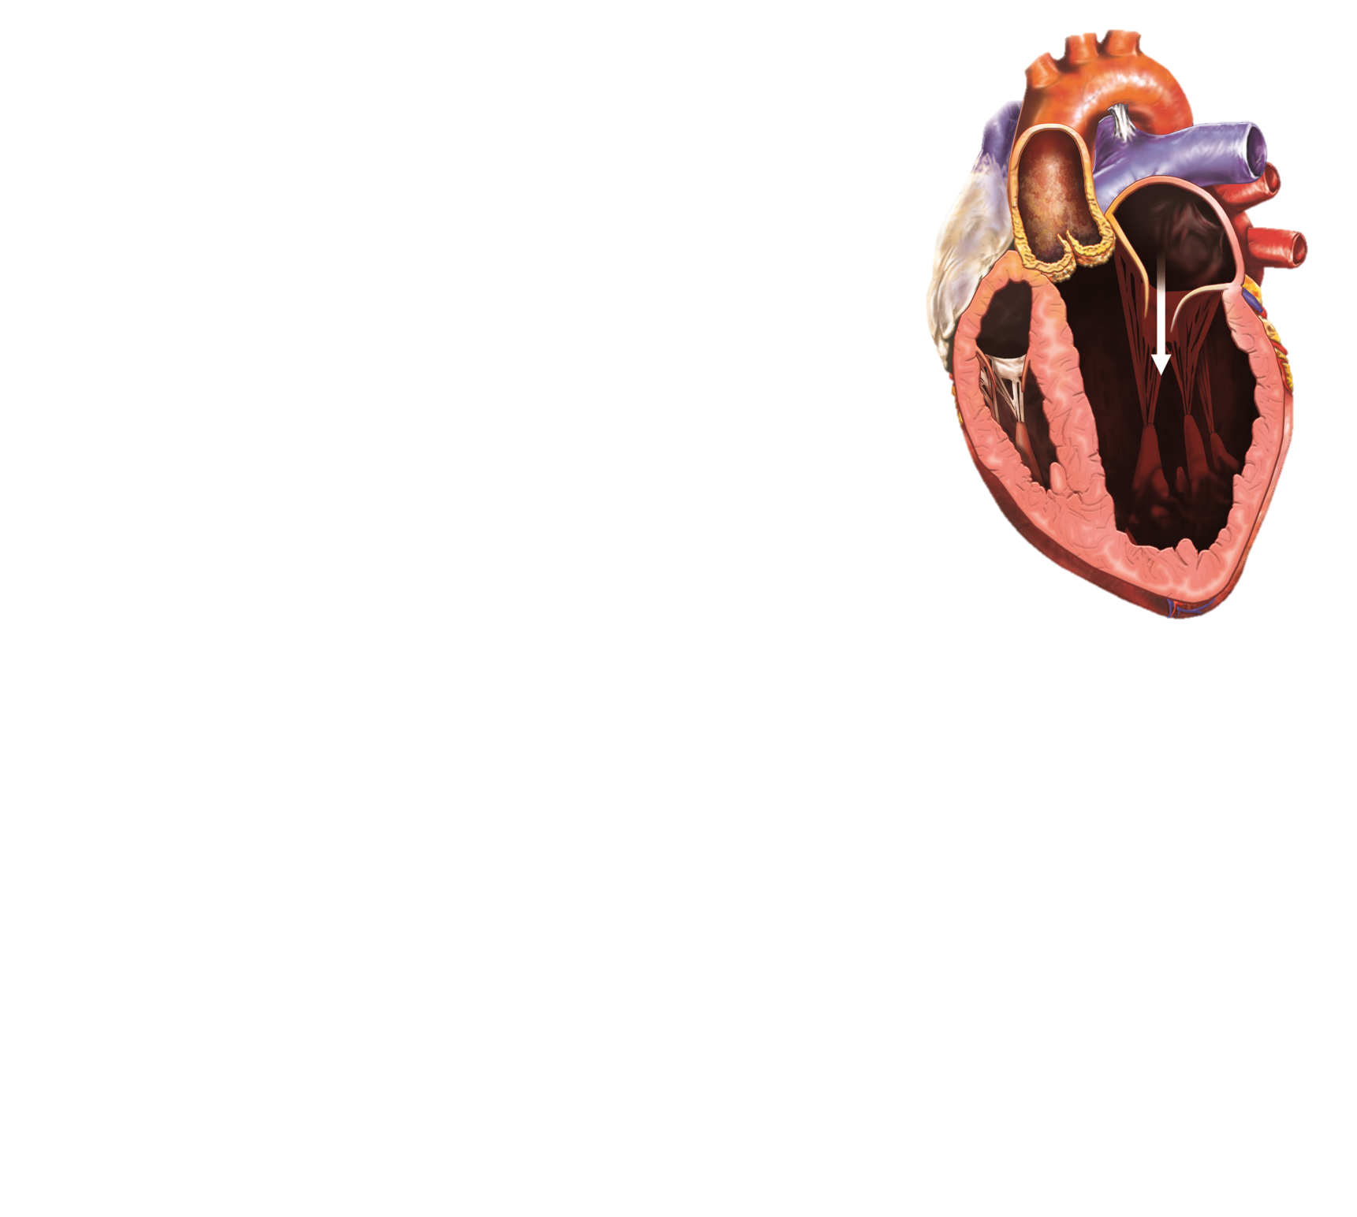
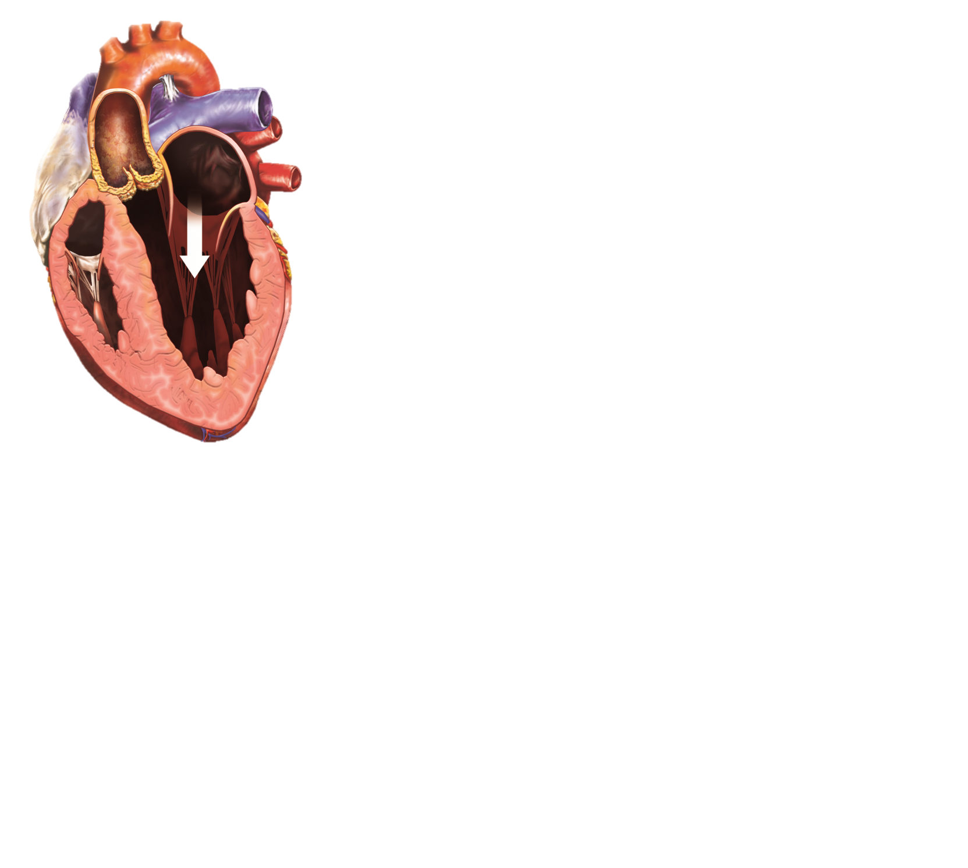
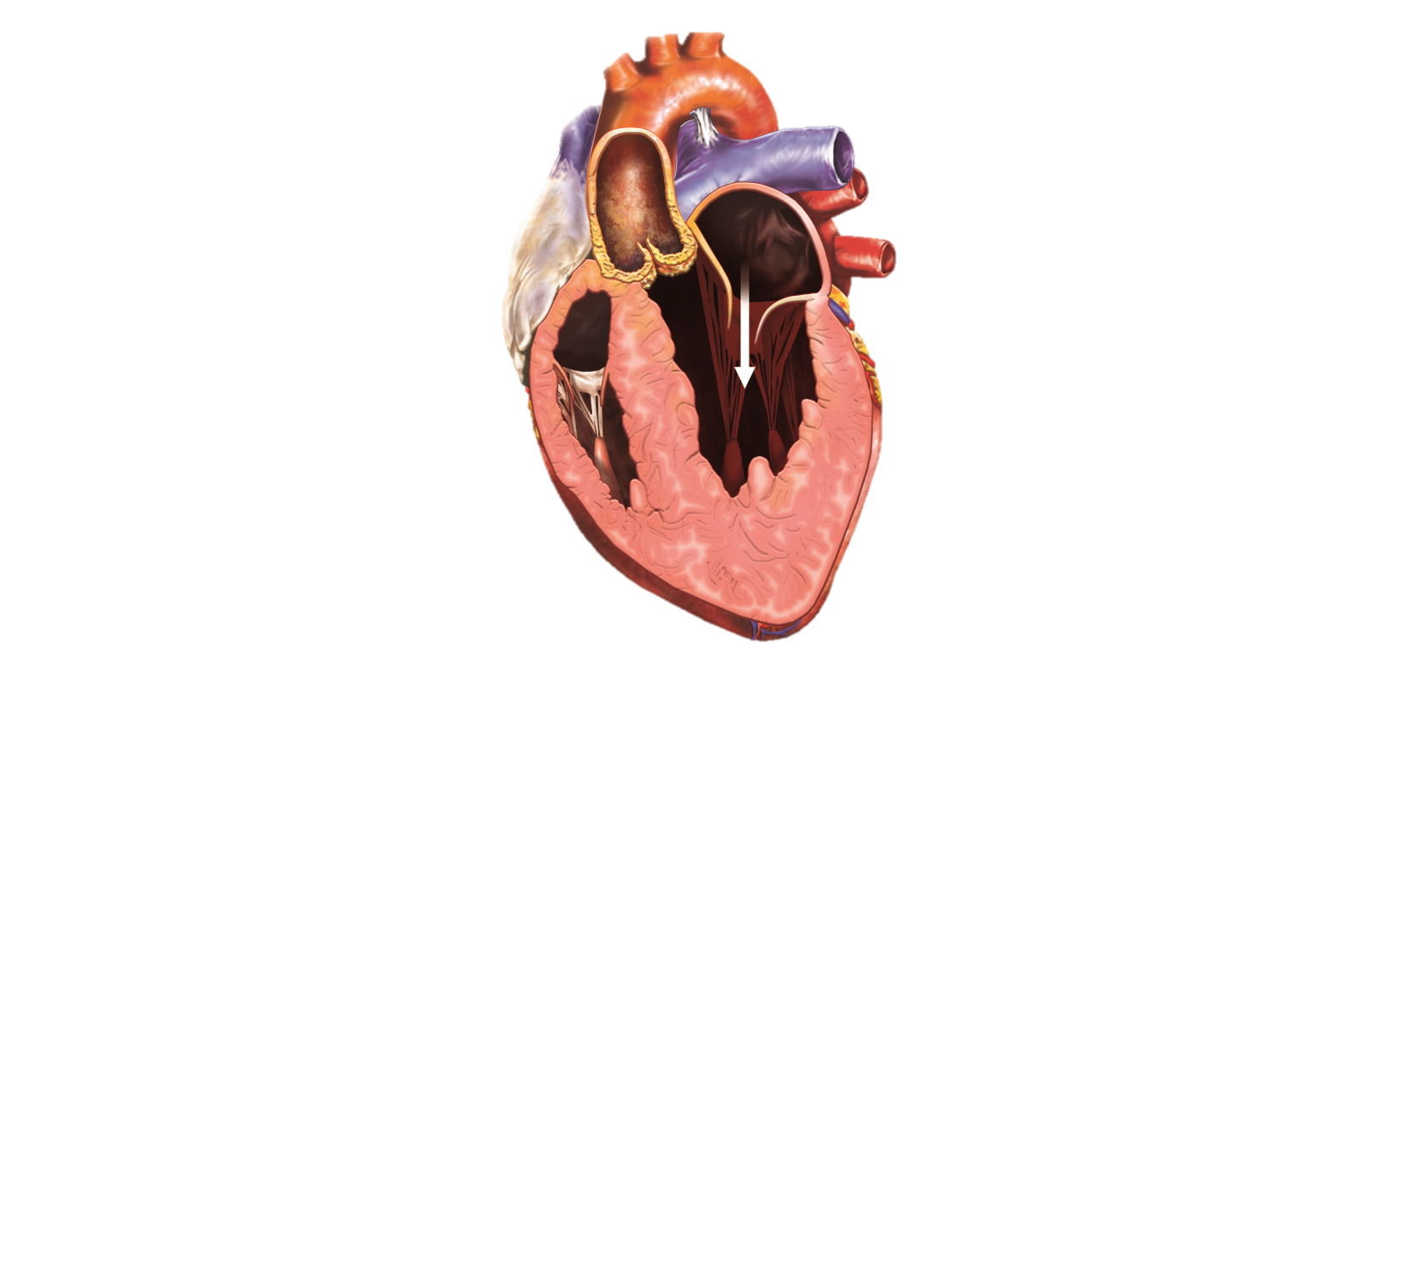
Two Different Patterns of Low-Flow, Low-Gradient AS
NORMAL-LVEF
NORMAL-FLOW
HIGH-GRADIENT
NORMAL-LVEF
«PARADOXICAL»
LOW-FLOW
LOW-GRADIENT
LOW-LVEF
«CLASSICAL»
LOW-FLOW
LOW-GRADIENT
50-70%
10-25%
5-10%

Slide 12
Echo approach to Aortic Stenosis
Valve anatomy 2d views, LVOT diameter
Exclude LV outflow trach obstruction
Stenosis severity:
a. Peak velocity
b. Mean pressure gradient
c. Continuity equation valve area
Degree of coexisting aortic regurgitation
Left ventricular hypertrophy and LVEF

Slide 14
Calcification affect LOVT measurement

Slide 15
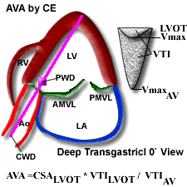

Slide 17
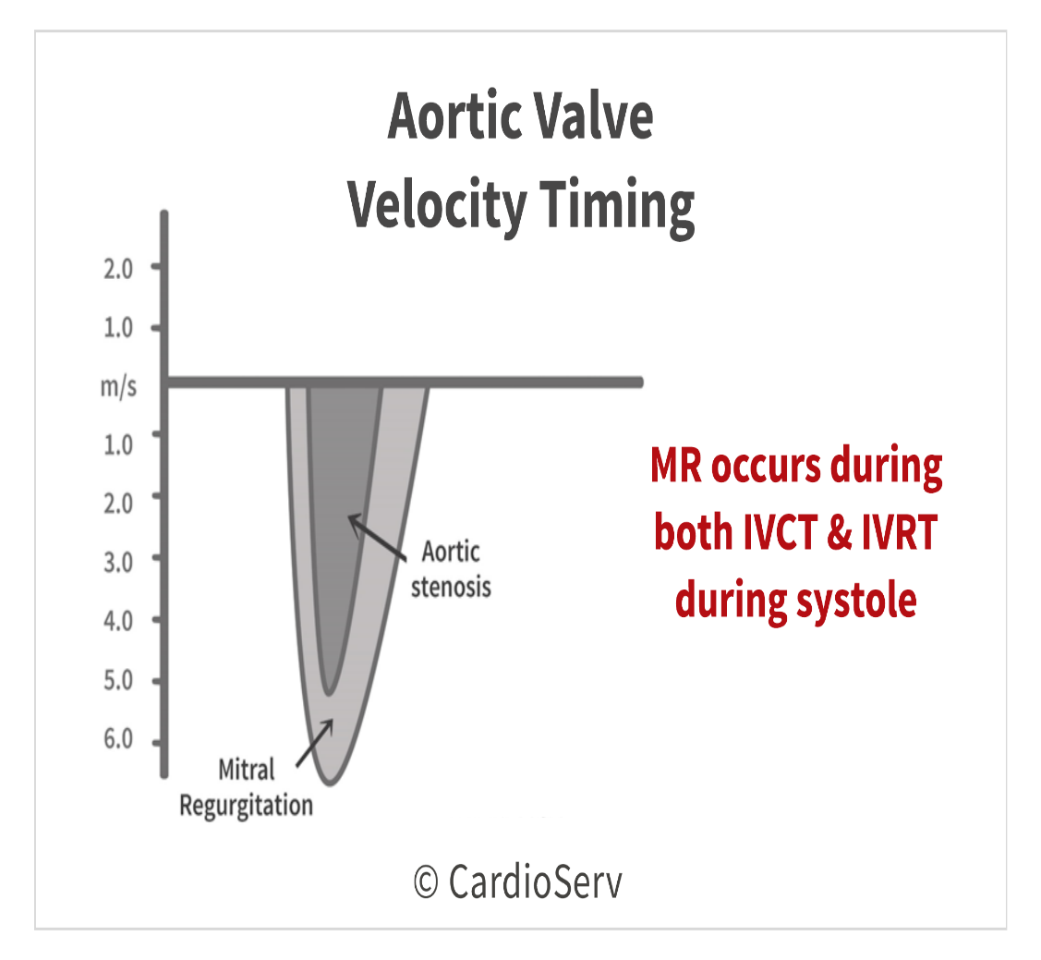

Slide 18
Pitfalls in Echo measurement
Outflow tract diameter images
Intercept angle between aortic stenosis jet and ultrasound beam
Identification of flow signal origin ( AS vs. MR. vs HOCM)
Beat to Beat variability ( AF, PVCs)
Respiratory motion affect acoustic window

Slide 20
Low gradient low flow AS
To differentiated low gradient is due to true aortic stenosis vs. pseudo aortic stenosis from Low LVEF related
It can be also seen in patient with normal LVEF (about 5-7% cases)
Criteria:
(i) AVA <1.0 cm²
(ii) mean aortic transvalvular pressure gradient <40 mmHg
(iii) LV ejection fraction <50%
(iv) SVi <35 mL/m².
Low-dose Dobutamin Echocardiogram can help distinguish between pseudo severe AS vs. true severe AS.

Slide 21
Dobutamine Echocardiography

Slide 22
Images at Baseline and after Dobutamine infusion

Slide 25
Low gradient AS with normal LVEF
Most challenging
Valve area <1.0 cm2, mean gradient <40mmHG, LVEF is normal or above 50%
Transvalvular flow SVi <35 ml/m2
Usually seen in elderly, with small LV cavity, more hypertrophy, HTN
Dobutamin echo may be helpful
Calcium score CT for aortic valve

Slide 27
Asymptomatic Severe Aortic Valve Stenosis
The management and the clinical decision making in asymptomatic patients with aortic stenosis are challenging.
An “aggressive” management, including early aortic valve replacement, is debated in these patients.
Optimal timing for surgery remains controversial due to the lack of prospective data on the determinants of aortic stenosis progression
Exercise stress testing with or without imaging is strictly contraindicated in symptomatic patients with severe aortic stenosis.
Exercise stress test is recommended by current guidelines in asymptomatic patients and may provide incremental prognostic value. Indeed, the development of symptoms during exercise or an abnormal blood pressure response are associated with poor outcome and should be considered as an indication for surgery
Exercise stress echocardiography may also improve the risk stratification and identify asymptomatic patients at higher risk of a cardiac event.
During exercise, an increase >18 to 20 mm Hg in mean pressure gradient, absence of improvement in left ventricular ejection fraction (i.e., absence of contractile reserve), and/or a systolic pulmonary arterial pressure >60 mm Hg (i.e., exercise pulmonary hypertension) are suggestive signs of advanced stages of the disease and impaired prognosis.

Slide 28
Stress Echocardiogram in AS

Slide 29
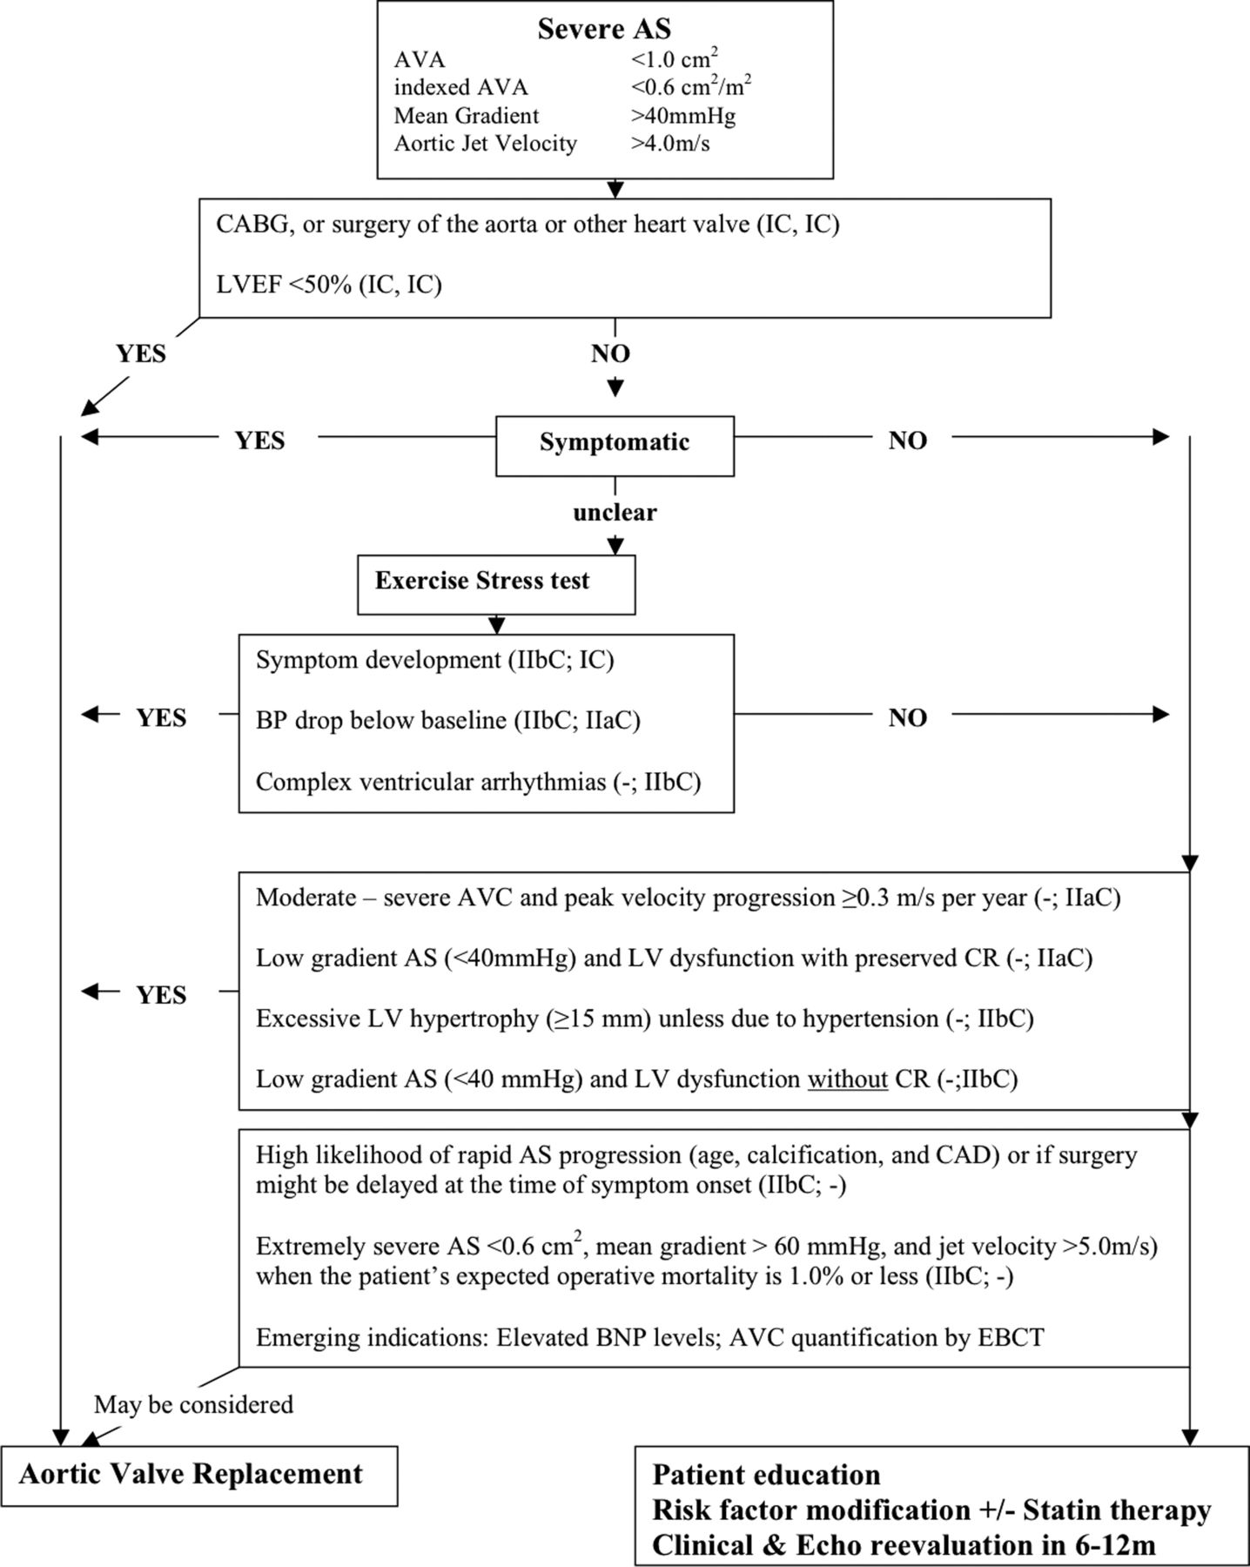

Slide 30
Summary
AVR is class I indication in patient with symptomatic severe aortic stenosis, improve survival significantly
Decision about timing of AVR in asymptomatic severe AS patients require careful assessment of risk and benefit ratio of AVR vs. watchful waiting
Exercise testing/stress echo in asymptomatic Severe AS patients provide for risk stratification and has prognostic valve
Need more prospective trials to assess Global Strain- LGS to detect early LV systolic dysfunction
Careful assessment of echocardiographic measurement help to differentiate between low flow low gradient from true vs. pseudo AS

Slide 31
CASE
A 64-year-old man is referred for systolic murmur and abnormal echocardiogram. He has a history of hypertension. He does not smoke, is physically active (walks briskly for three miles per day), and consumes a healthy diet. He has no symptoms. Medications include aspirin, high-intensity statin (atorvastatin), and angiotensin converting enzyme inhibitor. Blood pressure is 120/80 mmHg and heart rate is 65 beats per minute.
Echocardiogram: Normal biventricular systolic function, ejection fraction 60-65%, with mild concentric LVH Normal biatrial size Heavily calcified aortic valve, unable to discern valve morphology; Vmax 5 m/s, peak gradient 99 mmHg, mean gradient 60 mmHg, calculated aortic valve area 0.5 m2. (Figure 1) Pulmonary artery systolic pressure is 28 mmHg based on an RA pressure of 5 mmHg.

Slide 33
Which of the following is not correct?
Refer to surgical aortic valve replacement
Refer to Transcatheter aortic valve replacement
Treadmill exercise testing
Watchful waiting

Slide 34
Which of the following is not correct?
Refer to surgical aortic valve replacement
Refer to Transcatheter aortic valve replacement
Treadmill exercise testing
Watchful waiting

Slide 35
A patient with severe AS and CHF has mild mitral valve thickening and moderate MR.
Your advice to the surgeon is:
A. Aortic valve replacement and mitral valve repair
B. Aortic valve replacement only
C. Aortic and mitral valve replacement
D. Aortic valve replacement; re-evaluate MR by TEE
after coming off bypass.

Slide 36
A patient with severe AS and CHF has mild mitral valve thickening and moderate MR.
Your advice to the surgeon is:
A. Aortic valve replacement and mitral valve repair
B. Aortic valve replacement only
C. Aortic and mitral valve replacement
D. Aortic valve replacement; re-evaluate MR by TEE
after coming off bypass.

