Slide 1
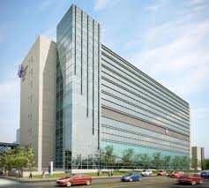
The Use of Echocardiography to Manage LVADs
William Cotts M.D., M.S. FACP, FACC, FAHA, FHFSA
Clinical Associate Professor, University of Illinois
Clinical Director, Mechanical Assistance and Heart Transplantation
Advocate Christ Medical Center

Slide 2
Disclosures
No affiliations with pharmaceutical or device companies

Slide 4
Stainback et al J Am Soc Echocardiography 2015;28:853909.

Slide 5
HeartMate II™ LVAD Pump
Flexible inflow conduit
Textured surfaces
Inlet cannula, inflow and outflow elbows
Thrombo-resistant
Outflow graft with bend relief
Anastomosed to LV apex and ascending aorta
Pump output varies over cardiac cycle
Follows native pulse
Afterload sensitive
Notes:
The flexible inflow conduit is designed for a wide range of patients, accommodating changes in anatomical position and allowing the inlet to remain centered in the ventricle. Both the inflow conduit and outflow elbow feature textured blood-contacting surfaces clinically proven on the HeartMate XVE to be thrombo-resistant.
The flexible inflow conduit is attached to the apex of the left ventricle, and the outflow graft is attached to the ascending aorta. The HeartMate II pumps blood from the weakened left ventricle to the aorta, the main artery feeding blood to the entire body.
Although HM II provides continuous flow, the pump output will vary over the cardiac cycle due to changes in LV and aortic pressure during LV diastole and systole. High afterload pressures will impede forward flow resulting in a decreased pump output.
The HM II flow is usually pulsatile. The degree of LV contraction will determine the amount of pulsatile flow through the pump.

Slide 6
Stainback et al J Am Soc Echocardiography 2015;28:853909.

Slide 7
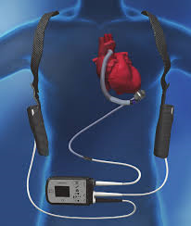
Heartmate III

Slide 8
LVAD vs OMM…Reality
30-80%
mortality
Notes:
Survival for an individual to get organ is very good…DT another story
1 year survival DT 68% (HM II trial)
2 year survival DT 58% (HMII trial)
REMATCH is dated and medical therapy vs VAD wont be done again. Many did not have CRT but CRT effect wanes, refining techniques but still stignificant number of nonresponders

Slide 9
Survival: National DT-LVAD Trial vs. Post Approval vs. ACMC (2014)
30 days
1 Yr
2 Yr
94%
78%
66%
Jorde et al. JACC 2014

Slide 10
Stainback et al J Am Soc Echocardiography 2015;28:853909

Slide 11
RV Dysfunction
RV size and function
TAPSE Tricuspid annular plane systolic excursion
Tricuspid regurgitation
RV free wall peak longitudinal strain < 9.6 % increased risk of RV failure
RV: LV EDD ratio of greater than 0.75

Slide 12
Aortic Insufficiency- Park Stitch vs biosprosthetic valve
Stainback et al J Am Soc Echocardiography 2015;28:853909

Slide 13
PFO unmasked with VAD
Stainback et al J Am Soc Echocardiography 2015;28:853909

Slide 14
Peri- operative TEE Checklist
Stainback et al J Am Soc
Echocardiography 2015;28:853909

Slide 15
Cannula Placement
Stainback et al J Am Soc
Echocardiography 2015;28:853909

Slide 16
Stainback et al J Am Soc
Echocardiography 2015;28:853909

Slide 17
Stainback et al J Am Soc
Echocardiography 2015;28:853909

Slide 18
Post-Implantation
Pericardial Effusion
LV Failure: Increase E wave diastolic velocity
Increased E/A and E/e’ ratio, worsening MR, increased PA pressure
RV Failure: Septum towards left, TR,
Inadequate filing: Small LV dimensions (<3 cm), Septum towards LV
LVAD suction: Should resolve with speed turndown
AI: AI prox jeft to LVOT hiegh ration > 46%, vena contracta > 3 mm
MR; Primary: inflow cannula interference, versus secondary: unloading issue
Intracardiac thrombus
Inflow cannula abnormality : positioning, > 1.5 cm CW Doppler velocity
Outflow graft > 2 m/s
Hypertensive emergency: New reduced AV opening
Pump malfunction or arrest: Decrease inflow and outflow graft velocities or signs of worsening HF

Slide 19
HM II Clinical Screen:
Pulsitility Index
5.0
Notes:
View parameters in contect of condition of pt
Ventricular contraction increases pump flow in systole → magnitude of these changes produces PI
Increased power in absence of flow → erroneously high flow
Flow increases with increased preload or decreased afterload in the aorta

Slide 20
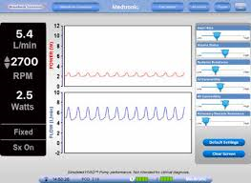
HVAD Clinical Screen

Slide 21
What to watch for on the Clinical Screen
Low flows → low CO, hypotension hypovolemia, obstruction
High flows → bearing wear, thrombus
High powers/watts → thrombus
PI events / flattened waveform → hypovolemia, cannula malposition, RV failure, excess pump speed

Slide 22
Is the VAD working?
Hemolysis: Elevated LDH, dark urine, increased plasma free hemoglobin
Congestion
Elevated Flows and Power

Slide 23
Key Echo findings: Don’t require an Echo expert!
Not able to close aortic valve
Mitral regurgitation
Enlarged chambers

Slide 24
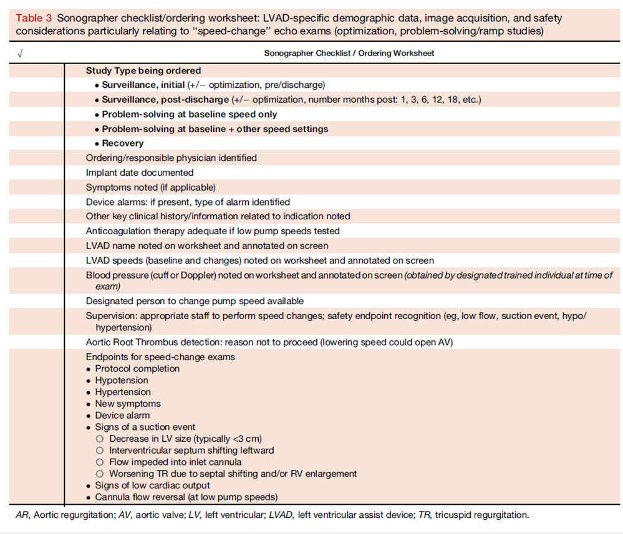

Slide 25
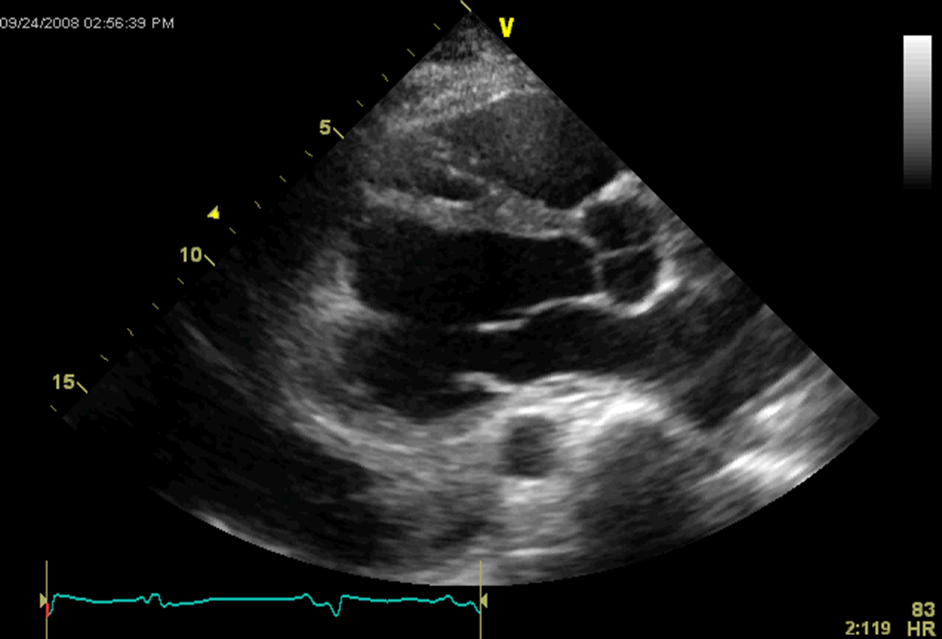
Aortic valve

Slide 26
Aortic Valve M Mode

Slide 27
Aortic Valve M Mode

Slide 28
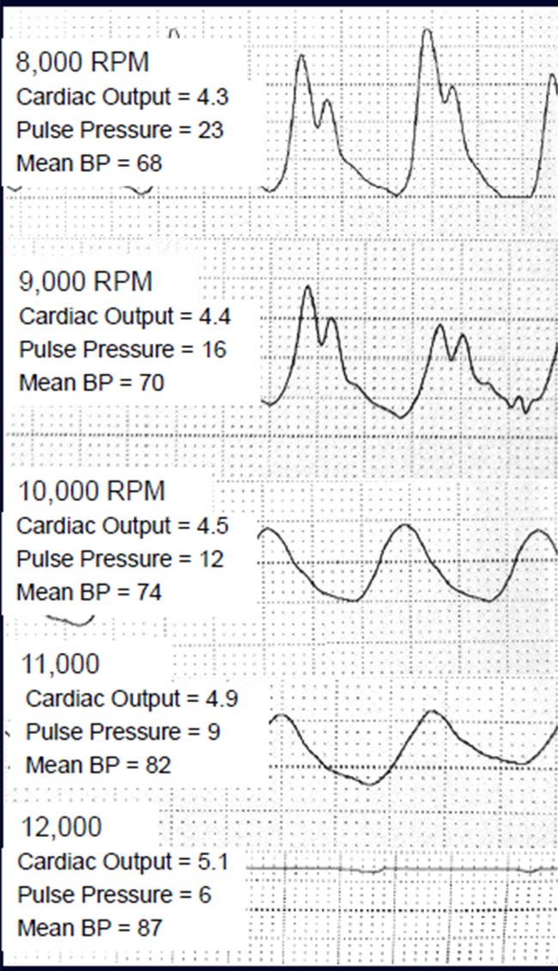

Slide 29
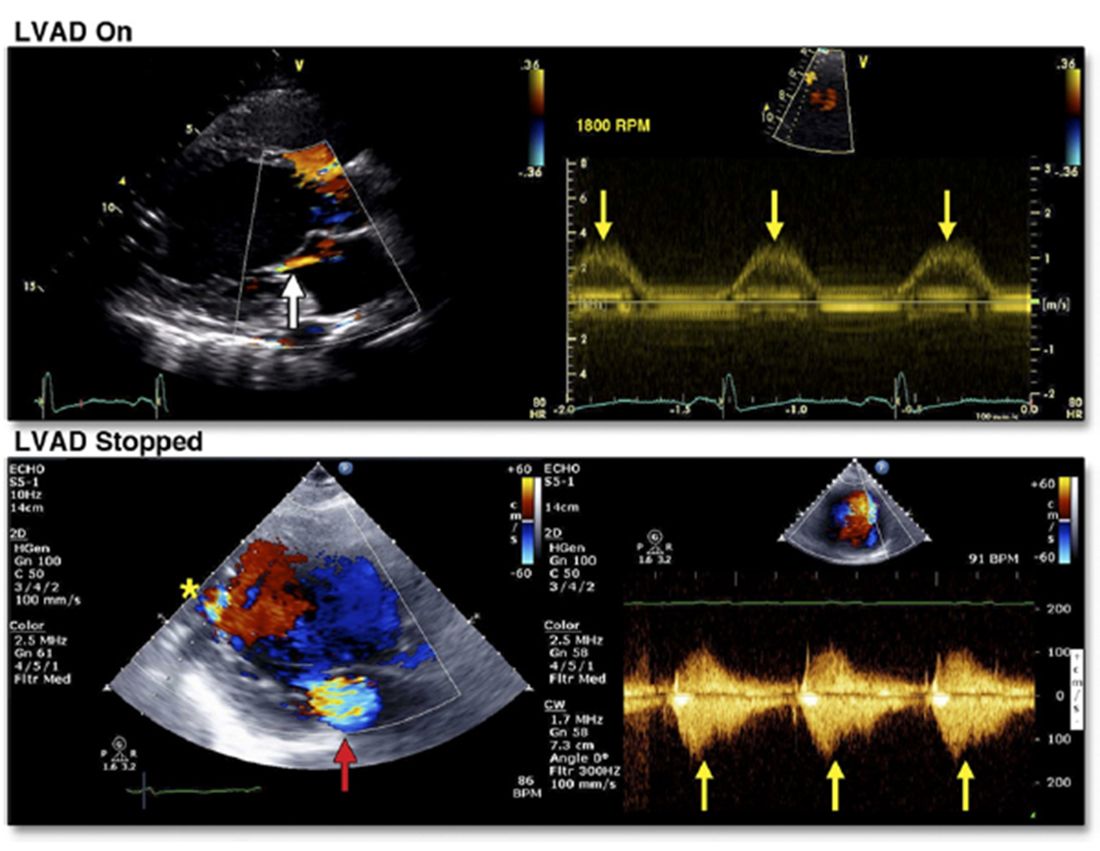
Pump stoppage and MR

Slide 30
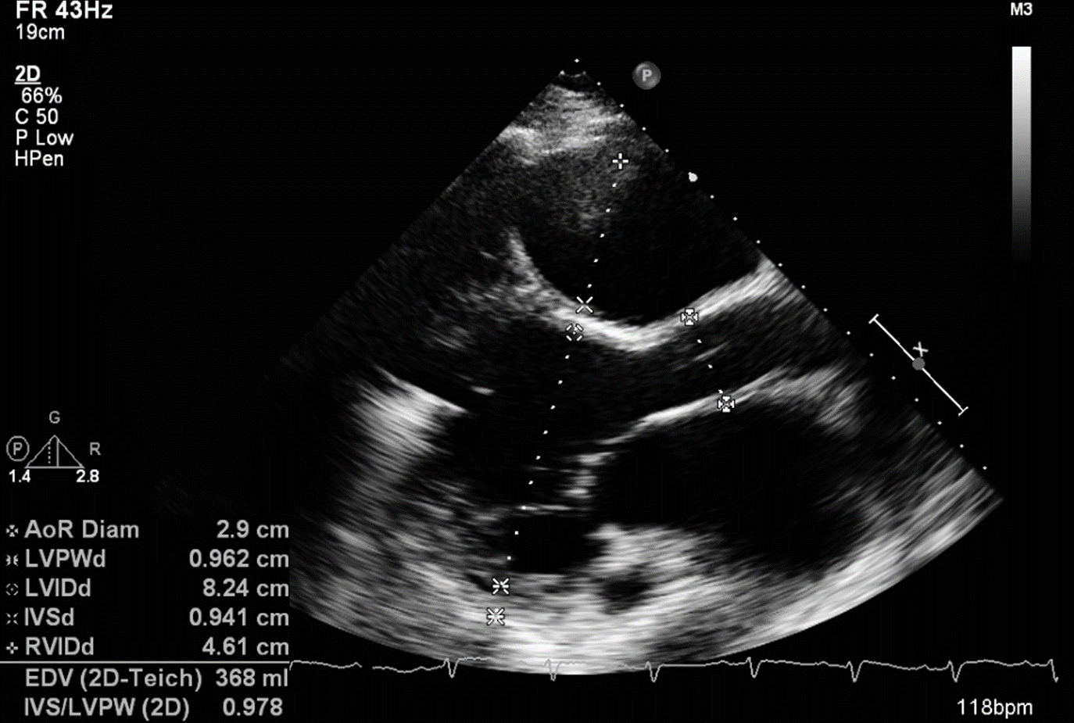
Chamber Measurements

